Slide 1
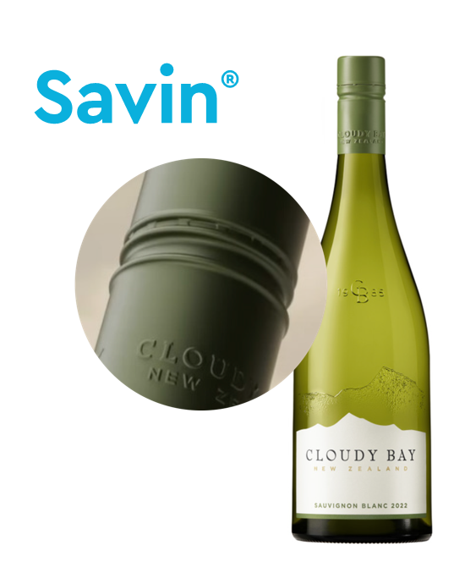
Savin Premium
INTRODUCTION TO

Slide 2
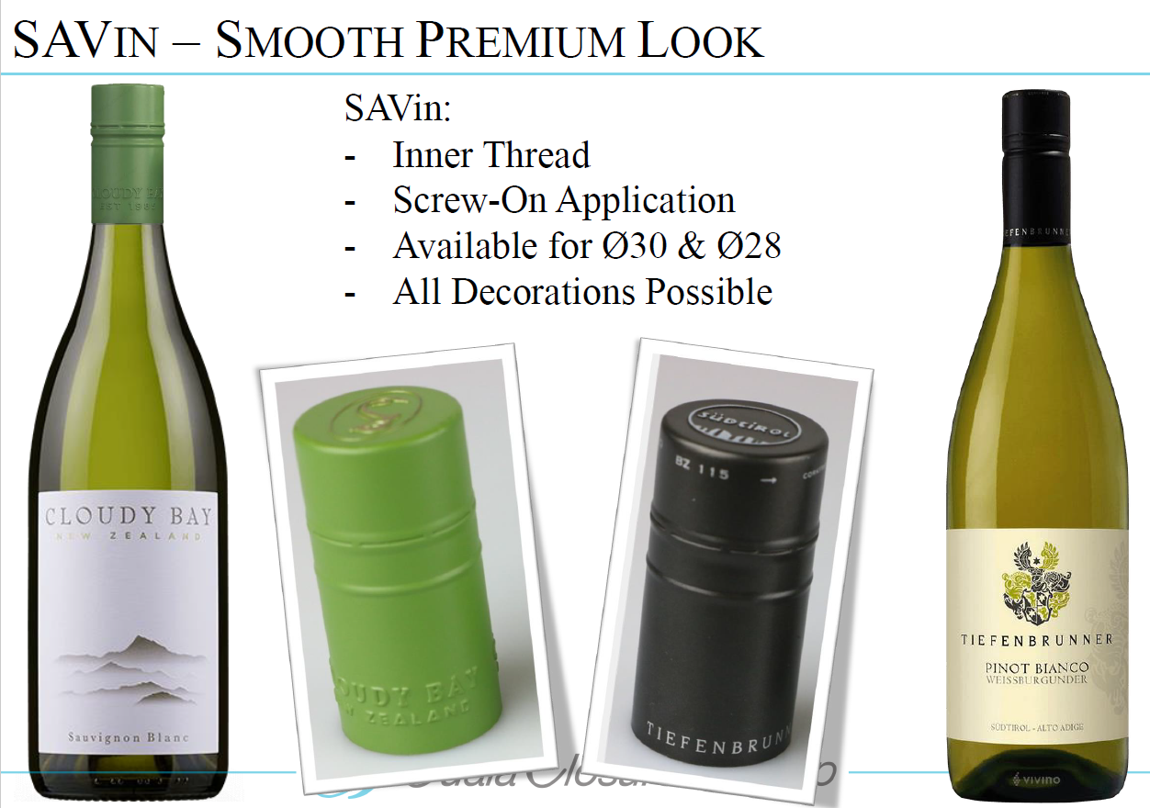

Slide 3


Slide 4

About
Guala
Meet the
30x60 wine
closure
Headquartered in Fairfield,
California, U.S.A.
Main 30×60 supply plant situated in Mexico.
Support supply plants located in Italy, Poland, Ukraine, Australia, New Zealand.

Slide 5
Contact
Sterling Macdonell
Sales Manager
sterling@gualaclosuresna.com
+1 707 804 9852
Randy Weller
Operations Director/Customer Technical Services
randy@gualaclosuresna.com
+1 707 266 4291
Shelly Sponseller
Customer Service/Supply Chain Manager
customerservice@gualaclosuresna.com
+1 707 591 355
Dave Campbell
General Manager
dave@gualaclosuresna.com
+1 707 688 52111

